Slide 1
Lecture 4 Basics of Research Design II
Dr.Uma Mohan

Slide 2
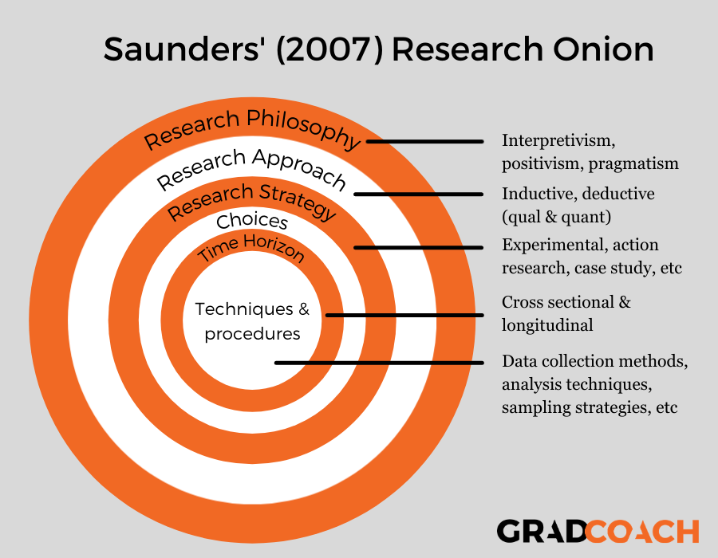
Research onion made simple Melnikovas, A., 2018. Towards an explicit research methodology: Adapting research onion model for futures studies. Journal of Futures Studies, 23(2), pp.29-44.

Slide 3

RESEARCH STRATEGIES
A Research Strategy is a step-by-step plan of action that gives direction to your thoughts and efforts, enabling you to conduct research ( operationalize) in a systematic way and on schedule to produce quality results and detailed reporting.
A research strategy is often impacted by the time and resources available for the research , particularly in Business Research and ethical considerations that need to be addressed.

Slide 4
RESEARCH STRATEGIES
EXPERIMENT *
SURVEY*
CASE STUDY ( secondary data)
ACTION RESEARCH*
GROUNDED THEORY*
ETHNOGRAPHY*
ARCHIVAL RESEARCH

Slide 5

EXPERIMENT
Used to study causal links
Whether a change in one independent variable produces a change in another dependent variable. Hakim (2000)
Tends to be used in exploratory and explanatory research to answer ‘how’ and ‘why’.

Slide 6

CASE STUDY
Involves empirical investigation of a particular contemporary phenomenon within its real life context using multiple sources. Robson (2002:178)
Has considerable ability to generate answers to the question ‘why’ as well as ‘what’ and ‘how’
May require the triangulation of multiple sources of data

Slide 7

SURVEY
Usually associated with the deductive approach
Popular and common strategy used in Business and Management research
Most frequently used to answer ‘who’, ‘what’, ‘where’, ‘how much’ and ‘how many’ questions.
Allows you to collect quantitative data which you can analyse using descriptive and inferential statistics
Comprises a cross-sectional design to which data are collected predominately by questionnaire or by structured interview on more than one case at a single time

Slide 8
Example of Survey
Favourite Chocolate Bar Survey
1) Which age range are you?
15 -20
21-30
30+
2) How often do you eat chocolate?
1-3 times a week
More than 5 times a week
Every day
I never eat chocolate
3) Which brand of chocolate is your favourite?
Cadbury
Nestle
Other

Slide 9
ACTION RESEARCH
Focuses upon and emphasises the purpose of the research: research in action rather than about action (Coglan and Brannick, 2005)
Relates to the environment of practitioners in the research and in particular a collaborative democratic partnership between practitioners and researchers
Emphasises the iterative nature of the process of diagnosing, planning, taking action and evaluating
It should have implications beyond the immediate project

Slide 10

GROUNDED THEORY
Data collection starts without the formation of an initial theoretical framework
Theory generated by a series of observations
Ideal example of the inductive approach

Slide 11

ETHNOGRAPHY
Purpose is to describe and explain the social world the research subjects inhabit in the way in which they would describe and explain it
The research process needs to be flexible and responsive to change as new patterns of thought about what is being observed are constantly being developed by the researcher
Rooted firmly in the inductive approach
Strategy is naturalistic

Slide 12

ARCHIVAL RESEARCH
Makes use of administrative records and documents as the principal source of data
Allows research questions which focus upon the past and changes over time to be answered, be they exploratory or descriptive

Slide 13
At this stage, we need to decide on another aspect- Quantitative versus Qualitative Design
Quantitative uses a positivism philosophy, deductive approach and numeric data
( survey or secondary data ) , whereas,
Qualitative uses an interpretivism philosophy, an inductive approach and non-numeric (words or text based) data ( interview or qualitative data )
However, Quantitative and Qualitative techniques and Procedures can be mixed or can be used on their own depending on the Research Questions you are trying to answer.

Slide 14
Research Design choices
Positivist Research Philosophy
Deductive Research Approach
Research strategy for quantitative data
Quantitative Data
Interpretivist Philosophy
Inductive Approach
Research strategy for quantitative data
Qualitative Data

Slide 15
What is the difference ?
Quantitative- Any data collection techniques (questionnaire or secondary data) or data analysis procedure ( mathematical - such as graphs or statistics) that generates or uses numerical data.
Qualitative- Any data collection technique such as (interviews or secondaray ) or data analysis procedure (such as thematic analysis ) that generates or uses non-numeric data, like text data .

Slide 16
Quantitative vs. Qualitative (Contd)
Quantitative research
systematically observe changes in the phenomena of interest while manipulating what are believed to be causal influences ( like impact of X on Y) or links between variables ( mathematical)
Qualitative research
may be more concerned with the individual’s personal experiences of the problem under study ( non- mathematical)

Slide 17
TIME HORIZONS
The choice of time horizon depends on the research question
Cross-sectional
Longitudinal

Slide 18
CROSS-SECTIONAL STUDIES
The study of a particular phenomenon (or phenomena) at a particular time
Snapshot view
Often employs survey strategy

Slide 19
LONGITUDINAL
Diary perspective
Observing people and events over time
Researcher is able to exercise a measure of control over variables being studied, provided they are not affected by the research process itself

